Slide 1
www.MINEPORTAL.in
ONLINE TEST SERIES FOR
DGMS COAL/METAL FIRST/SECOND CLASS EXAM
GATE MINING EXAM
OVERMAN EXAM TEST
MINING INSPECTOR EXAMS
COAL INDIA MTs & OTHER PSUs EXAMS
FREE STUDY MATERIAL & VIDEO LECTURES
MINING JOBS NOTIFICATIONS
www.mineportal.in Call/Whatsapp-8804777500 www.fb.com/mineportal.in

Slide 2
Methods to find out mean point of swinging tape in gyrotheodolite
The equation of motion, equation (1), is exactly the same whether the spinner is spinning or not.
The only difference is in the values of the terms in the equation. When the spinner is spinning then the term K is the same as B in equation (2).
When the spinner is not spinning then the term K is the same as d in equation (2).
Observations may be made, either of time as the moving shadow mark passes scale divisions, or of the extent of the swing of the moving mark on the gyro scale. This is known as a turning point as it is the point at which the moving mark changes direction.
In this latter case precise observations can only be made if the GAK1 is fitted with a parallel plate micrometer that allows the image of the moving shadow mark to be made coincident with a scale division. The reading on the parallel plate micrometer is then algebraically added to the value of the observed scale division.
There are a number of methods available for finding K .
Two are presented as follows:

Slide 3

Amplitude method
The scale value is observed at three or four successive turning points. With the motion of the moving mark slightly damped by hysteresis in the tape and air resistance, the damped harmonic motion of the moving mark is of the form described by equation (1) which can be rearranged as:
y = K + Me^{−Dt} cos(ω(t − p))----------------(3)
y₀+3y₁+3y₂+y₃
For non spin mode d_{i}=>
8 ---------------(4)
For spin mode B_{i} => -----------------------(5)
To be successful the amplitude method requires an element of skill and experience. The observer must have light and nimble fingers to make the observations with the micrometer while not disturbing the smooth motion of the suspended gyroscope.
The slightest pressure on the gyro casing may set up a 2 Hz wobble on the shadow mark making reading difficult and inaccurate. For ease of reading, at the next turning point, the micrometer should be returned to zero. This is easily forgotten especially in the non-spin mode when there will be at most 25 seconds before the next reading.

Slide 4
Transit method
In the transit method the observations are of time. The effect of the damping term is assumed to be negligible.
Four observations of time are made as the moving shadow mark crosses specific divisions on the gyro scale.
The parallel plate micrometer must of course be set to zero throughout these observations.
Three of the times, t₀, t₁ and t₂, are when the moving shadow mark passes a scale division, y₀, near the midpoint of swing and the other, t_{r} , is when the moving shadow mark passes a scale division, y_{r}, near a turning point.
To do this in practice, first drop the mast, and see the approximate extent of the swing in both the positive and negative directions.
Find the scale division nearest the centre of swing and a scale division close to the turning point. This division must not be so close to the turning point that there is a chance that the moving mark’s swing might decay, so that the moving mark does not go far enough on subsequent swings.
The first part of the swing may be to either side of the 0 scale division.

Slide 5
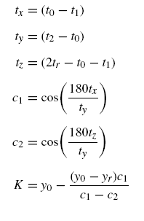
Having chosen the scale divisions which are to be y₀ and y_{r} , wait until the moving mark approaches the y₀ scale division in the direction of y_{r} . Take the time t₀.
Next, time the moving mark as it crosses the y_{r} scale division, t_{r} . It does not matter whether the moving mark is on its way out, or on the return towards y₀ for this time.
The final two times, t₁ and t₂, are as the moving mark successively crosses y₀.
Formulae:
(6)

Slide 6
The practical solution of the north finding equation
To solve the north finding equation, equation (2), each of the terms must be solved for.
In the above section, on the practical solution of the equation of motion, two methods were presented for the solution of B and d, the scale readings for the centres of swing in the spin and non-spin modes respectively.
In practice d will be determined twice, before and after the determinations of B. The two solutions might vary a little because of heating effects in the gyro and stretching and twisting of the tape.
If the two determinations of the midpoint of swing in the non-spin mode are d₁ and d₂ then the value of d is taken as:
d₁ + 3d₂
d = --------------------(7)
4
The weightages in equation (7) is purely arbitrary but reflects best experience.

Slide 7

To find the torque ratio constant, C, two sets of observations are made with the theodolite pointing a little either side of north. Equation (2) may be applied to each set of observations as follows:
N = H₁ + sB₁(1 + C) − sCd + A one side of north-----------[2(i)]
N = H₂ + sB₂(1 + C) − sCd + A the other side of north-----[2(ii)]
If equation [2(ii)] is taken from equation [2(i)] then:
0 = (H₁ − H₂) + s(B₁ − B₂)(1 + C)
and so, on making C the subject of the equation:
-----------------(8)
Therefore, to determine the torque ratio constant for the instrument, the horizontal circle reading of the theodolite is taken for each pointing of the theodolite, a little east and a little west of north, when the observations for the determination of the midpoint of swing in the spin mode are made. Once the torque ratio constant C has been found then the value will hold for all observations over a limited latitude range of about 10 of arc, or about 20 km in a north–south direction.

Slide 8

Alternatively if C is observed and computed, C₁ at latitude φ₁, its value, C2 at latitude φ₂, may be found from:
-----------------------------(9)
Practical observations
Firstly, an approximate direction of north is required. This may be obtained from known approximate coordinates of the instrument and another position, from a good magnetic compass provided that the local magnetic deviation and individual compass error are well known, an astronomic determination of north, or most easily from the use of the gyro in the ‘unclamped method’.
In the unclamped method the mast is dropped in the spin mode. Instead of the theodolite remaining clamped and the moving mark being observed, the theodolite is unclamped and the observer attempts to keep the moving mark on the 0 division by slowly rotating the theodolite to follow the moving mark.

Slide 9
At the full extremities of this motion the theodolite is quickly clamped up and the horizontal circle is read.
The mean of two successive readings gives a provisional estimate of north.
If the difference between the two readings is greater than a few degrees it is best to repeat the process starting with the theodolite at the previous best estimate of north before dropping the mast.
The precision of this as a method of finding north is, at best, a few minutes of arc. That is provided that a steady hand is used, the moving mark is kept strictly on the 0 division and that the value of d, the centre of swing on the gyro scale when the spinner is not spinning, is strictly 0. The whole process takes about 10 to 15 minutes.
Having achieved pre-orientation, the user is then ready to make sufficient observations to find the horizontal circle reading equivalent to north, or more likely, the azimuth of a Reference Object (RO).

Slide 10
The suggested order of observations, irrespective of the method of finding K (amplitude or transit), is as follows:
Point to RO. Horizontal circle reading (RO) H_{RO}
Point the theodolite about half a degree to the west of north
Horizontal circle reading (fix) H₁
Observations for centre of swing, non-spin mode K = d₁
Observations for centre of swing, spin mode K = B₁
Point the theodolite about half a degree to the east of north
Observations for centre of swing, spin mode K = B₂
Observations for centre of swing, non-spin mode K = d₂
Horizontal circle reading (fix) H₂
Point to RO. Horizontal circle reading (RO) H_{RO}
The solution is then found from equations (1) to (8).

Slide 11
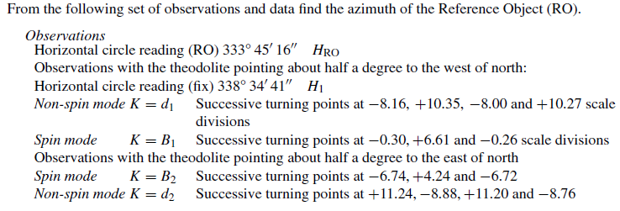

Example: Amplitude method

Slide 12
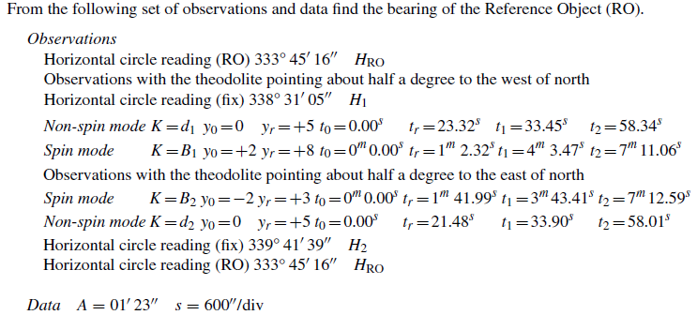
Example: Transit method

